Slide 1
Adversarial Attack & Future Work
Kim Seung Hwan (overnap@khu.ac.kr)
2022. 12. 30.

Slide 2
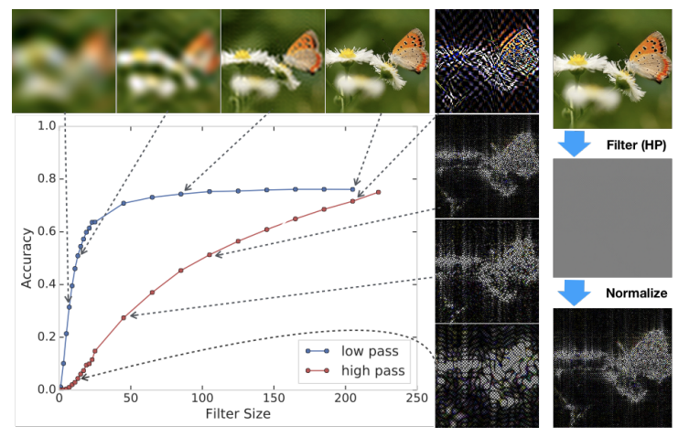
What I learned from Adversarial Attack
What is DNN model really learning?
From D. Yin et al. “A Fourier Perspective on Model Robustness in Computer Vision”

Slide 3
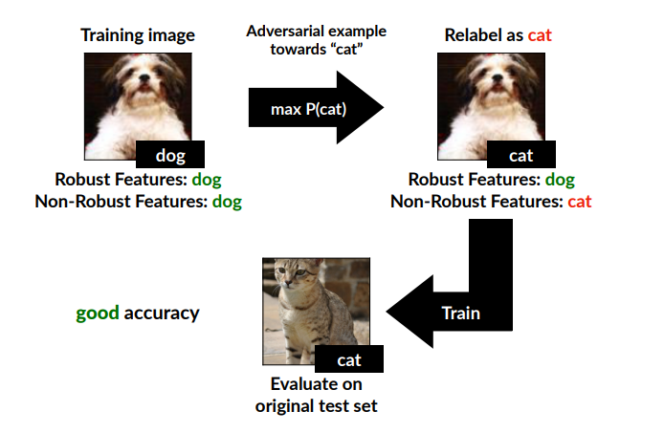
What I learned from Adversarial Attack
What is DNN model really learning?
From A. Ilyas et al. “Adversarial Example Are Not Bugs, They Are Features”

Slide 4
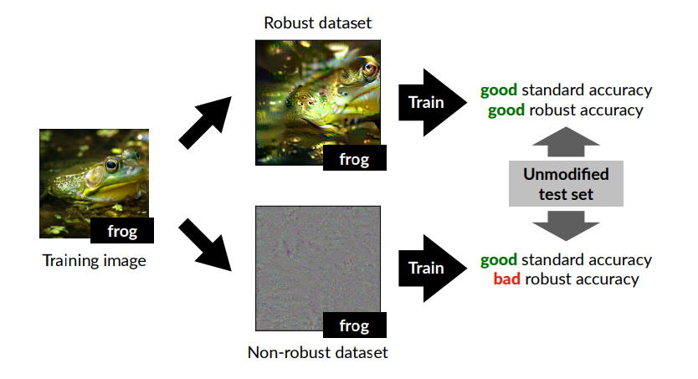
What I learned from Adversarial Attack
What is DNN model really learning?
From A. Ilyas et al. “Adversarial Example Are Not Bugs, They Are Features”

Slide 5
What I learned from Adversarial Attack
DNN models learn more (or completely different) information than humans
These are generally different from human perception
This is because models are forced to decrease loss only
So, is Adversarial Vulnerability evil?
Do models really need to mimic human perception?

Slide 6
What I wrote
“비선형적 이미지 혼합 데이터 증강을 이용한 Deep Neural Network의 적대적 공격 취약성 개선”
“Adversarial Vulnerability Improvement by Non-linear Image Mixing Data Augmentations”

Slide 7
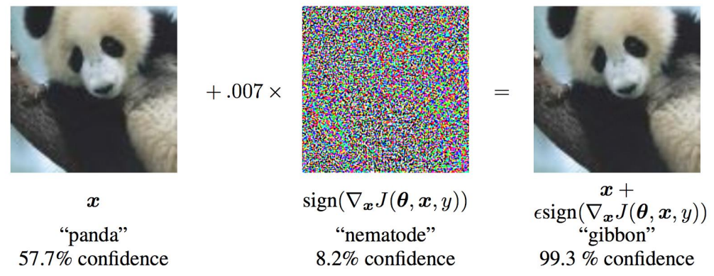
1. Background
Adversarial Attack is to fool a DNN model by perturbing inputs that are difficult for humans to perceive
Such vulnerability is an obstacle to the application of DNNs in areas where security or reliability are important (e.g., A.D.)
FGSM method; from I. Goodfellow et al. “Explaining and Harnessing Adversarial Examples”

Slide 8
1. Background
Adversarial Transferability, which means that other models trained on similar datasets can also be fooled, implies a black-box attack
This suggests that not only the architecture of models, but also the dataset itself has a lot to do with the vulnerability
Recent studies explain that this is because models mainly extract features that are useful but not robust (i.e., vulnerable to attack)

Slide 9
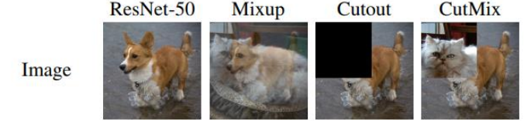
1. Background
Data augmentation is essential in modern DNN training
Data augmentation, however, is also associated with the adversarial vulnerability, as it changes the distribution of datasets
For this study, let’s focus on mixing augmentations (e.g., Mixup, CutMix)
They perform well and are so universal; they are essential to achieving SOTA
From S. Yun et al. “CutMix: Regularization Strategy to Train Strong Classifiers with Localizable Features”

Slide 10
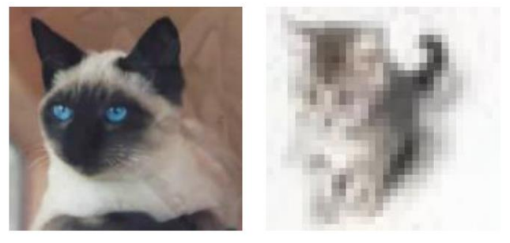
2. Proposal
Despite the great improvement of mixing augmentations, linear blending of labels is questionable
Humans barely recognize dogs in 1:9 images of dogs and cats
But since models need to find 10% of the dogs, it will learn finer features that are difficult for humans to see

Slide 11
2. Proposal
Useful but less robust features tend not to match human perception, so we need to check them in terms of adversarial vulnerability
From A. Ilyas et al. “Adversarial Example Are Not Bugs, They Are Features”

Slide 12
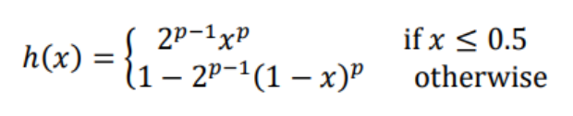

2. Proposal
Set an appropriate function $h$ to mimic human perception
$h$ is a function that attenuates small signals and strengthens strong signals
In this study, $h$ is set as follows ($p$ is a non-linear parameter)

Slide 13
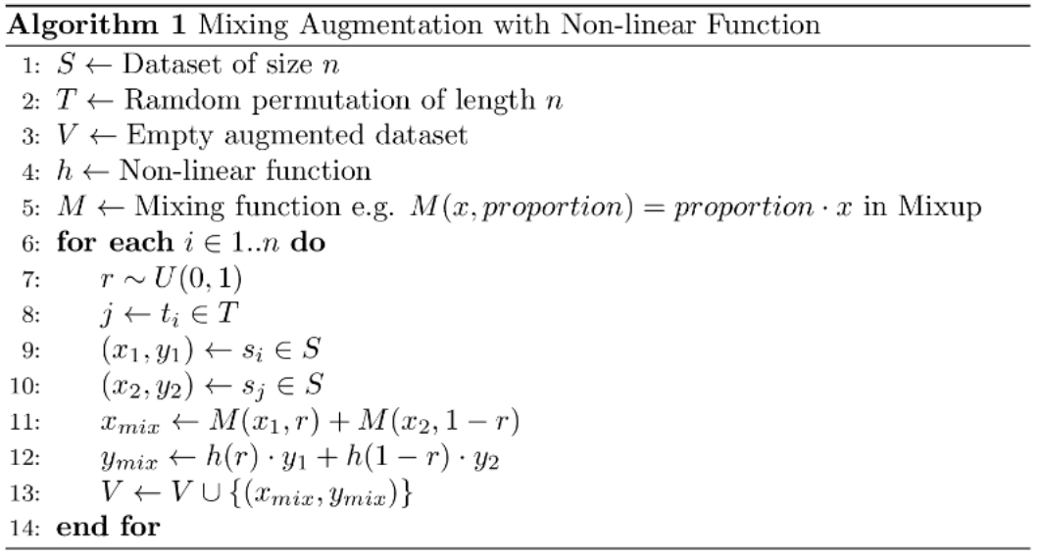

2. Proposal
Leave the mixing input images as is and pass the label value to merge into $h$ (lines 4 and 12)

Slide 14
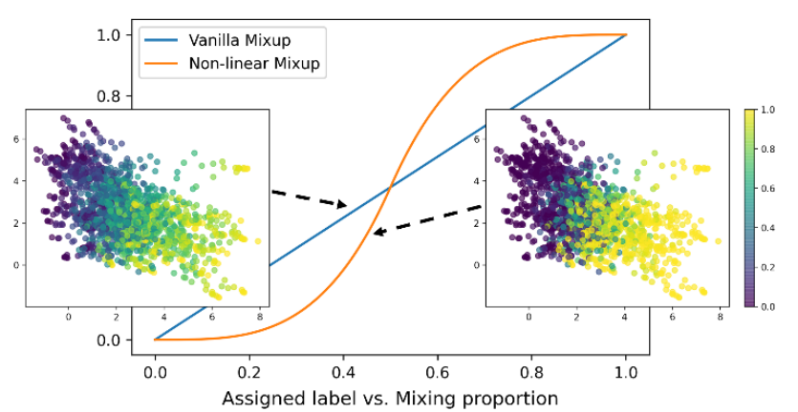
2. Proposal

Slide 15
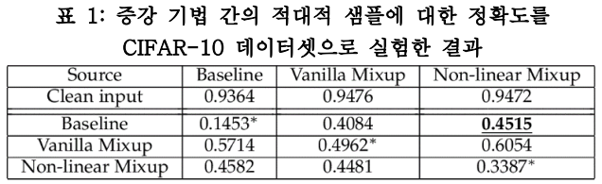
3. Experiment
ResNet-50, CIFAR-10, Mixup, FGSM
Linear mixing augmentation vs proposed non-linear one (p=6)
Maintain the improvement of linear (conventional) mixup
Superior in the black-box, inferior in the white-box

Slide 16
3. Experiment
Empirically verifying the hypothesis
Let’s look at it from a different perspective
The proposed non-linearity leads to steeper decision boundaries of the model

Slide 17

3. Experiment
Adversarial examples are found around or beyond boundaries
Steep boundaries have little information about the location of decision boundaries and are insensitive to attacks from incorrect directions, which reduces the convergence of attacks
For an attack in the right direction, a large change is obtained with a small move, which explains the inferiority in the white box

Slide 18
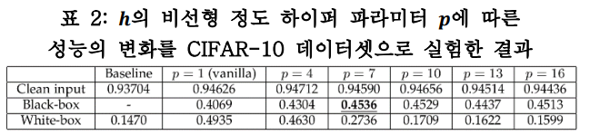
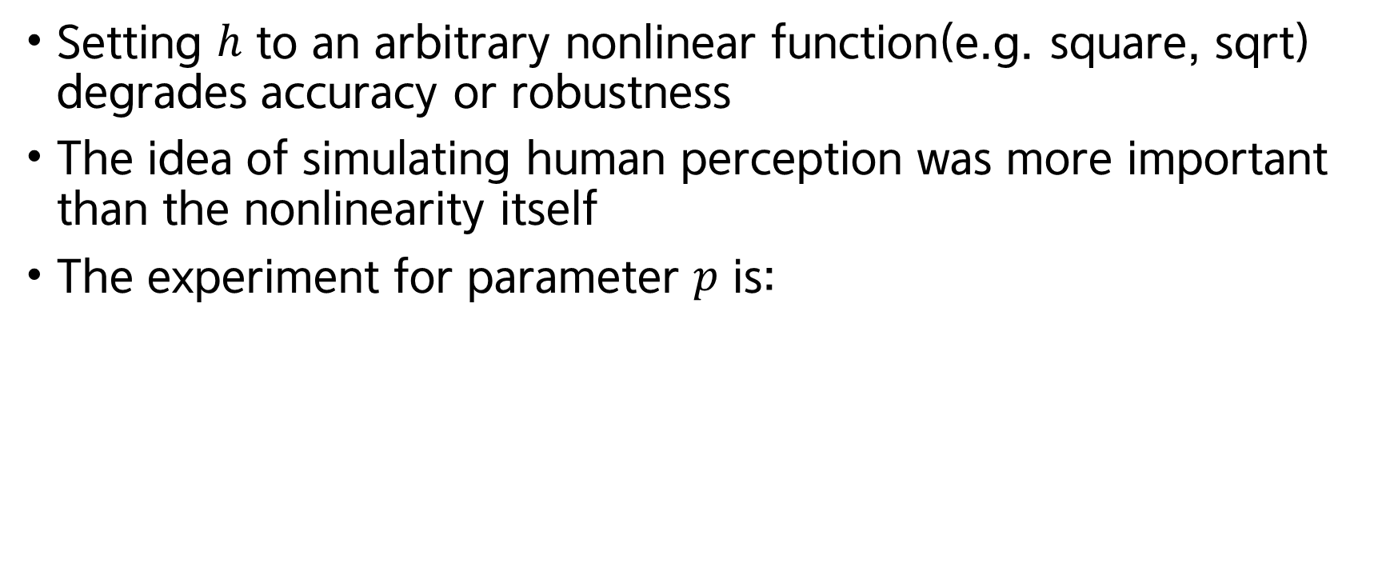
3. Experiment
Setting $h$ to an arbitrary nonlinear function(e.g. square, sqrt) degrades accuracy or robustness
The idea of simulating human perception was more important than the nonlinearity itself
The experiment for parameter $p$ is:

Slide 19
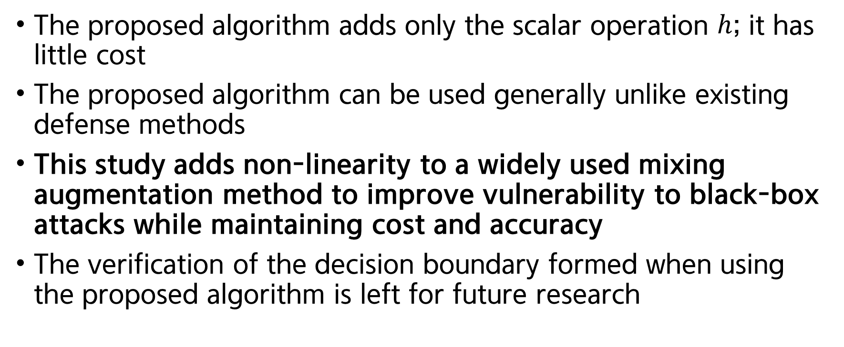
4. Conclusion
The proposed algorithm adds only the scalar operation $h$; it has little cost
The proposed algorithm can be used generally unlike existing defense methods
This study adds non-linearity to a widely used mixing augmentation method to improve vulnerability to black-box attacks while maintaining cost and accuracy
The verification of the decision boundary formed when using the proposed algorithm is left for future research

Slide 20
What to improve
Lack of quantitative comparison with existing studies
Leap from the question to the solution (the proposed algorithm)
Good metric?

Slide 21
Topics for winter
The first is a comparison of samples that are misclassified by the robust models and those that are not
The two models seem to be learning completely different things
Then it seems that the samples where the twos are mostly wrong can be qualitatively different

Slide 22
Topics for winter
The second is a determining if an image has been trained in a generative model (Mr. H.S. talked about)
I simplify this to determining in a classification task
It is a difficult problem even under such simple condition

Slide 23
Small experiments
Adversarial attack perspective, let’s see the distance to the D.B.
Adversarial attack is about crossing decision boundaries
Approximate the distance to the decision boundary by running a binary search with the attack
In fact, the average of the perturbation required by the valid set of images was stronger than that of the train set
But the variance was large that it was not significant

Slide 24
Small experiments
Decision boundaries fail... What about logit itself?
I think that data points already learned in the logit plane form a mode (in the context of overfitting)
Think of images as points (i.e., vectors), not tensors
Then the three images will form a plane in data space
Observe the logit plane for three images of the same class

Slide 25
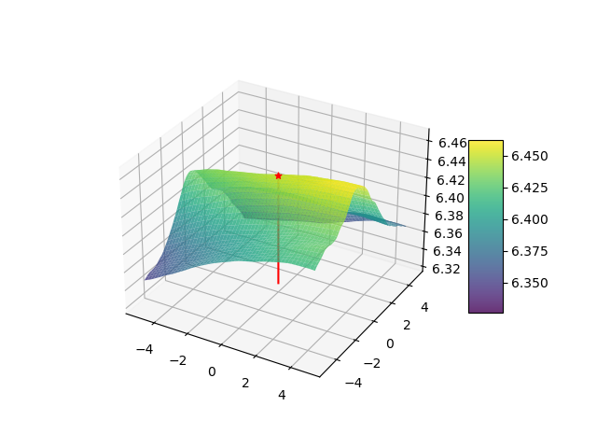
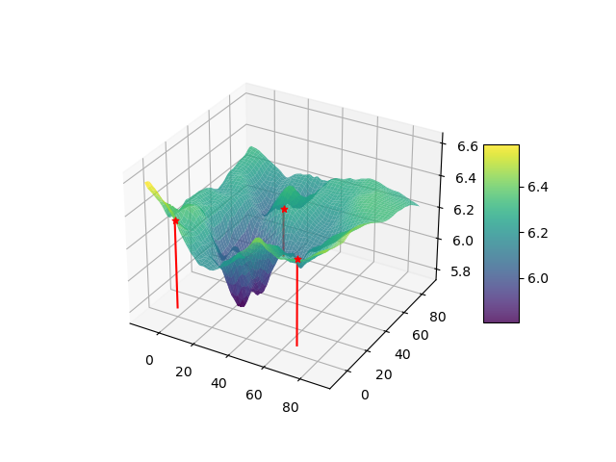
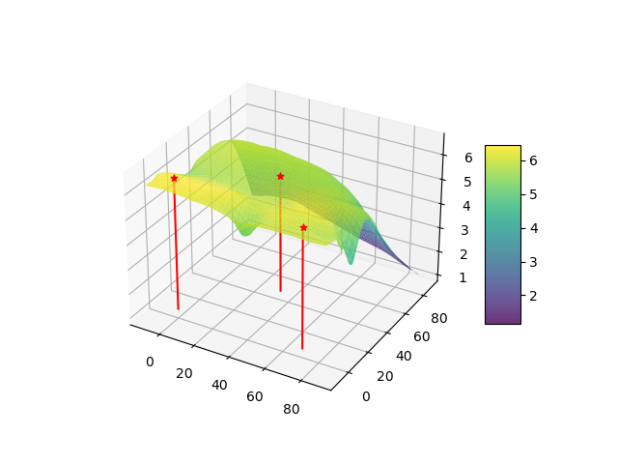
Small experiments

Slide 26
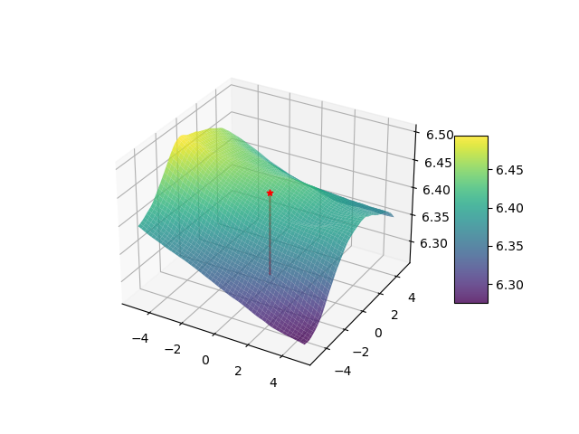
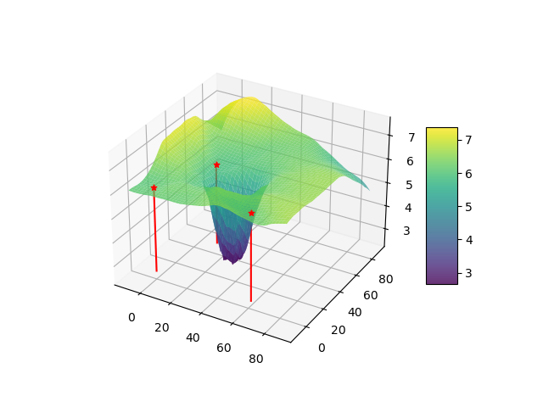
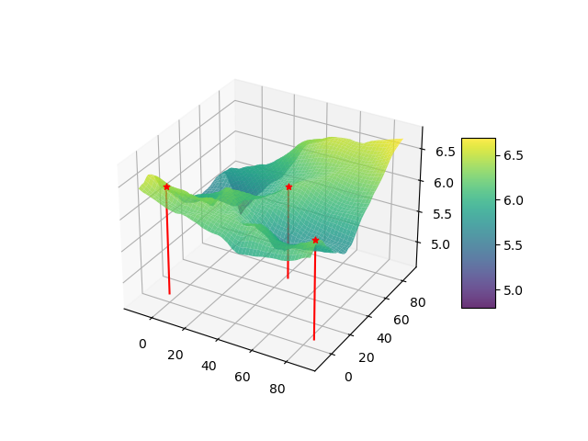
Small experiments

Slide 27
Thank you for listening
Kim Seung Hwan (overnap@khu.ac.kr)
2022. 12. 30.

